Slide 1
MEASURE OF CENTRAL TENDENCY

Slide 2
Measures of Central Tendency
Measures of central tendency yield information about “particular places or locations in a group of numbers.”
Common Measures of Location
  Mode
  Median
  Mean
  Percentiles
  Deciles
  Quartiles

Slide 3
Mode
The most frequently occurring value in a data set
Applicable to all levels of data measurement (nominal, ordinal, interval, and ratio)
Bimodal -- Data sets that have two modes
Multimodal -- Data sets that contain more than two modes

Slide 4
Mode -- Example
The mode is 44.
There are more 44s
than any other value.
35
41
44
45
37
41
44
46
37
43
44
46
39
43
44
46
40
43
44
46
40
43
45
48

Slide 5
Mode
For un group or normal data…..it is item or number occurring with maximum frequency. Mode may be more than one in a set of data.
For group or frequency data
= L₁ + {(f_{m} – f₁)/(2f_{m}-f₁-f₂)} h
L₁ – lower class boundary of the modal class
h – width of modal class
f_{m} – frequency of the modal class (max freq)
f₁ – frequency preceding to modal class
f₂ – frequency following the modal class

Slide 6
Median
Middle value in an ordered array of numbers.
Applicable for ordinal, interval, and ratio data
Not applicable for nominal data
Unaffected by extremely large and extremely small values.

Slide 7
Median: Computational Procedure
First Procedure
  Arrange observations in an ordered array.
  If number of terms is odd, the median is the middle term of the ordered array.
  If number of terms is even, the median is the average of the middle two terms.
Second Procedure
  The median’s position in an ordered array is given by (n+1)/2.

Slide 8
Median: Example with an Odd Number of Terms
Ordered Array includes:
3 4 5 7 8 9 11 14 15 16 16 17 19 19 20 21 22
There are 17 terms in the ordered array.
Position of median = (n+1)/2 = (17+1)/2 = 9
The median is the 9th term, 15.
If the 22 is replaced by 100, the median remains at 15.
If the 3 is replaced by -103, the median remains at 15.

Slide 9
Median
For group/frequency data
L₁ + h/f {(sum of f/2) –cf}
L₁ lower class boundary of median class
h width of median class
f frequency of median class
Sum f is the sum of all the frequecies
Cf is cumulative frequency preceding to median class

Slide 10
Mean
Is the average of a group of numbers
Applicable for interval and ratio data, not applicable for nominal or ordinal data
Affected by each value in the data set, including extreme values
Computed by summing all values in the data set and dividing the sum by the number of values in the data set

Slide 11
Mean
For un group data X(bar) = summation of all x/n
For group data X(bar) = sum of all fx/n

Slide 12
Quartiles
Measures of central tendency that divide a group of data into four subgroups
Q₁: 25% of the data set is below the first quartile
Q₂: 50% of the data set is below the second quartile
Q₃: 75% of the data set is below the third quartile

Slide 13
Quartiles, continued
Q₁ is equal to the 25th percentile
Q₂ is located at 50th percentile and equals the median
Q₃ is equal to the 75th percentile
Quartile values are not necessarily members of the data set

Slide 14
Quartiles
Q₁
Q₂
Q₃
25%
25%
25%
25%

Slide 15
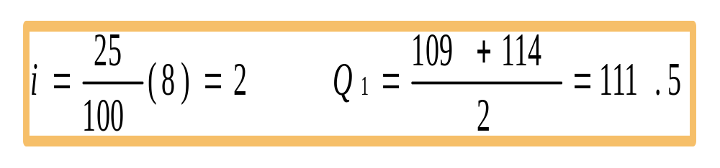
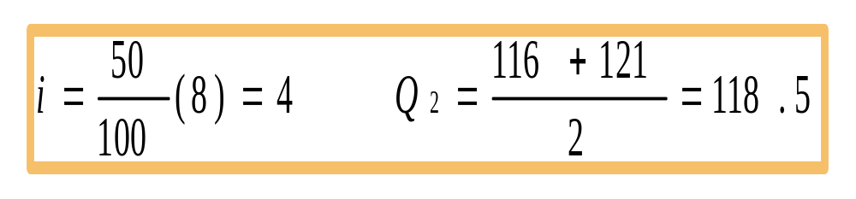
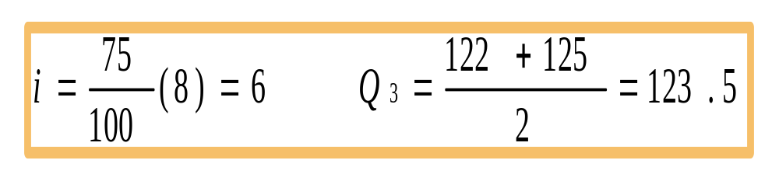
Quartiles: Example
Ordered array: 106, 109, 114, 116, 121, 122, 125, 129
Q₁:
Q₂:
Q₃:

